Slide 1
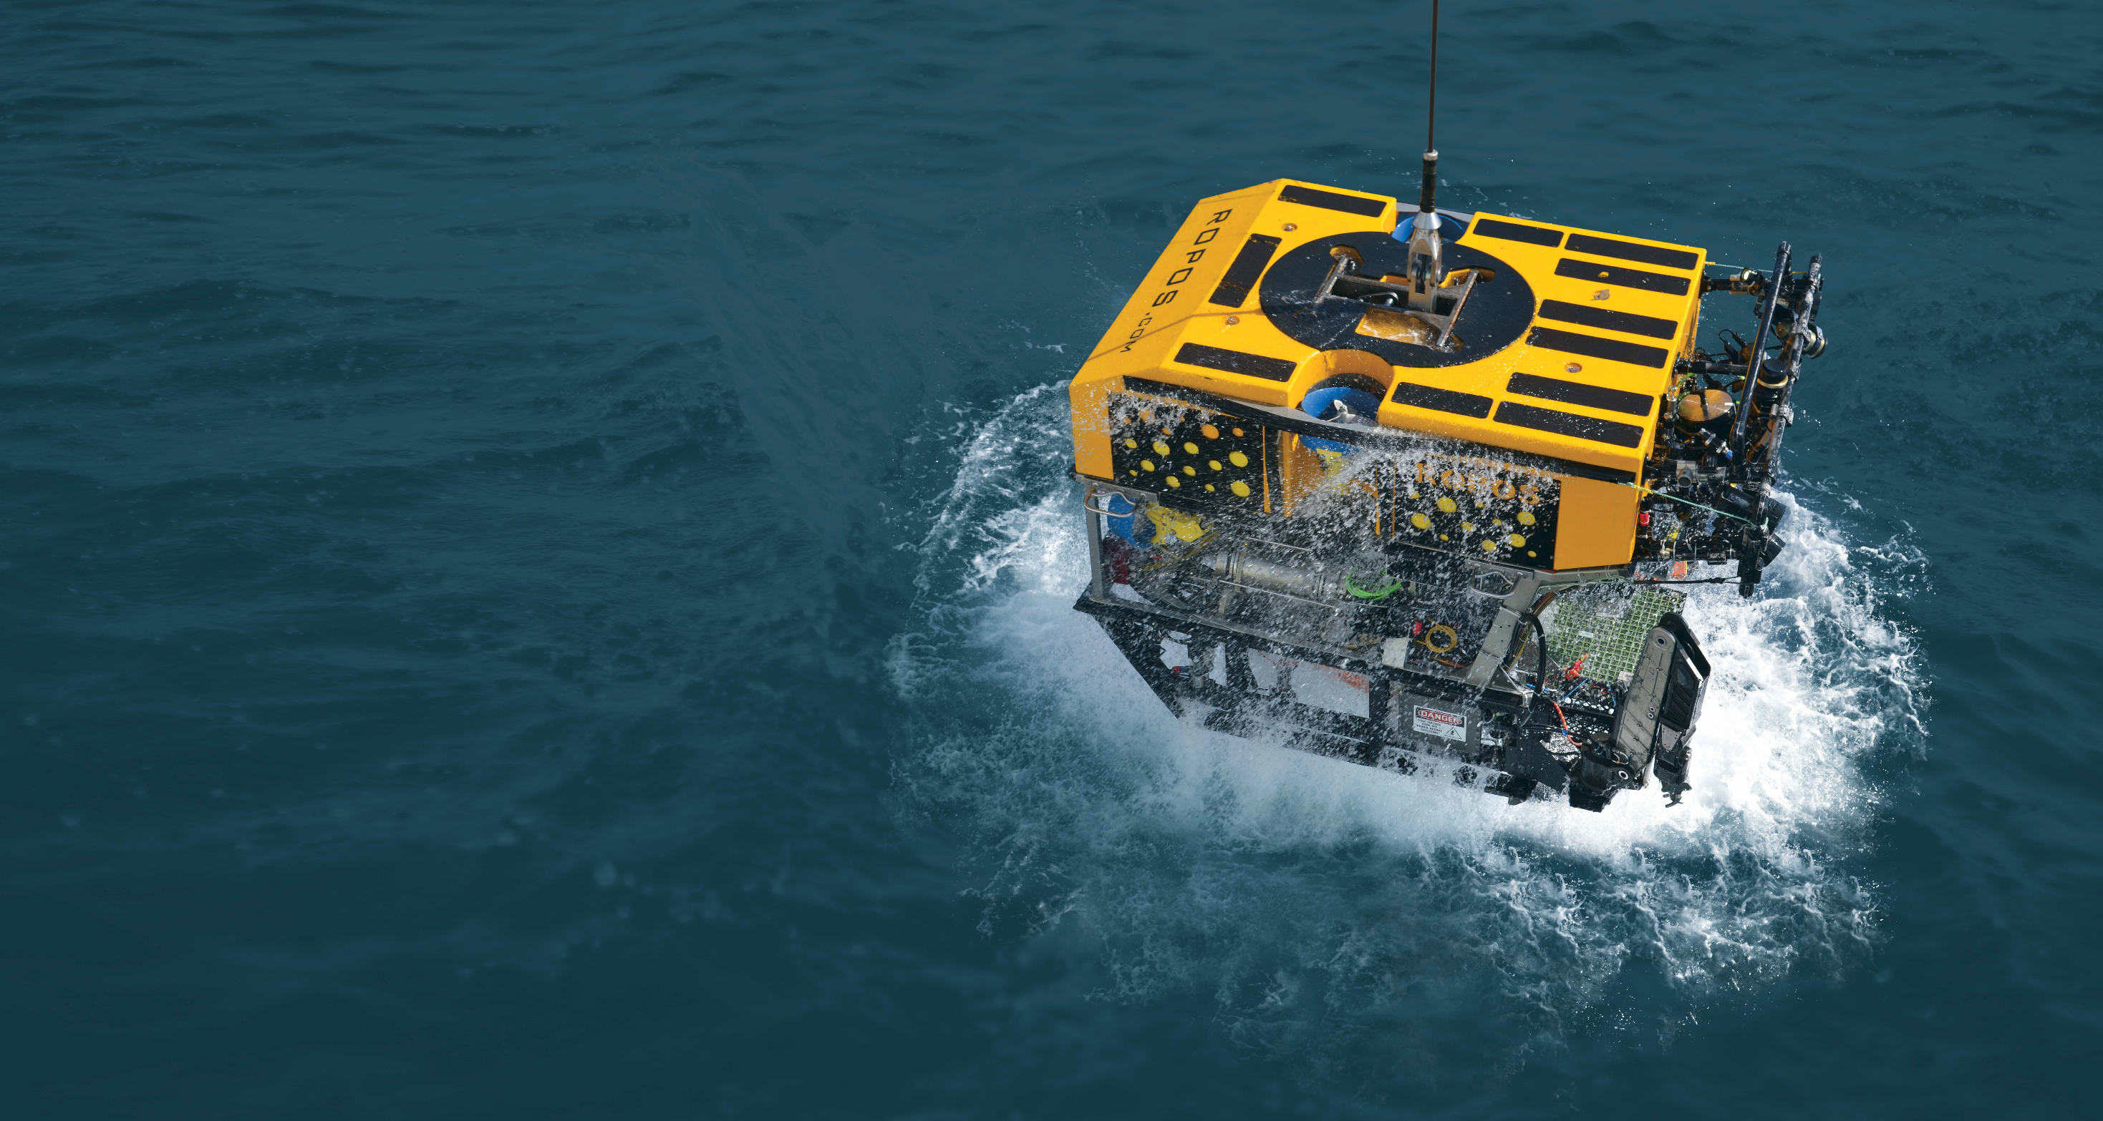
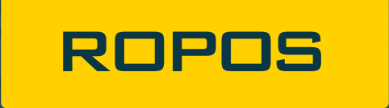
CSSF IRLS
Vincent Auger
auger@ropos.com
Establishing Community Standards for Underwater Video Acquisition,
Tagging, Archiving, and Access
Community Workshop
June 1 – 2 , 2016
ROPOS.COM

Slide 2

INtegrated Real-time Logging System
DESIGN
IRLS was designed to help our users organize and document the wide range of activities performed during ROPOS dives in an interactive logbook.
The system specifications were originally drawn from a survey of ROPOS users.
Ability of the system to adapt to various user requirements and preferences was a primary design goal.
IN A NUTSHELL
In its simplest form, IRLS can be thought of as a web-based logbook where every observation is automatically annotated with time, position, and vehicle attitude. It however offers much more such as:
Several loggers to work together by entering data simultaneously from various stations in a conversation-style interface.
Observations to be classified with data tags as well as specific dive activities such as samples, video transects, or any type of time series.
Add descriptive framegrabs from any ROPOS camera or other user-uploaded files such as PDF documents and images that can enhance observations.

Slide 3
Organizational elements

Slide 4
USER ROLES
Privileges group | Privileges
Investigator | Can review all data but is not allowed to modify or delete any
Logger | Investigator privileges and: Can create, modify, and delete: Observations Observation series Samples
Principal Investigator | Logger privileges and: Can create a new dive Create, modify, and delete: Metadata tags Scientists Sites Can export data in CSV, Google KMZ, Zip, and HTML formats
Administrator | Principal Investigator privileges and: IRLS user management Merge or delete dives Other administrative tasks

Slide 5
planning
A little planning will go a long way in creating a useful and powerful logbook using IRLS. While it is possible to use log observations in a simple sequential manner, it does have a variety of organization elements that can represent all of the activities you plan on doing with the vehicle.
Before an expedition, we recommend the creation of a logging strategy that the chief scientist would share with all individuals logging observations. This strategy should clearly explain how the organizational elements will be used during the expedition.
The chief scientist should also compile lists of sites, scientists, metadata, and the various naming schemes to use during the expedition.

Slide 6
Logging

Slide 7
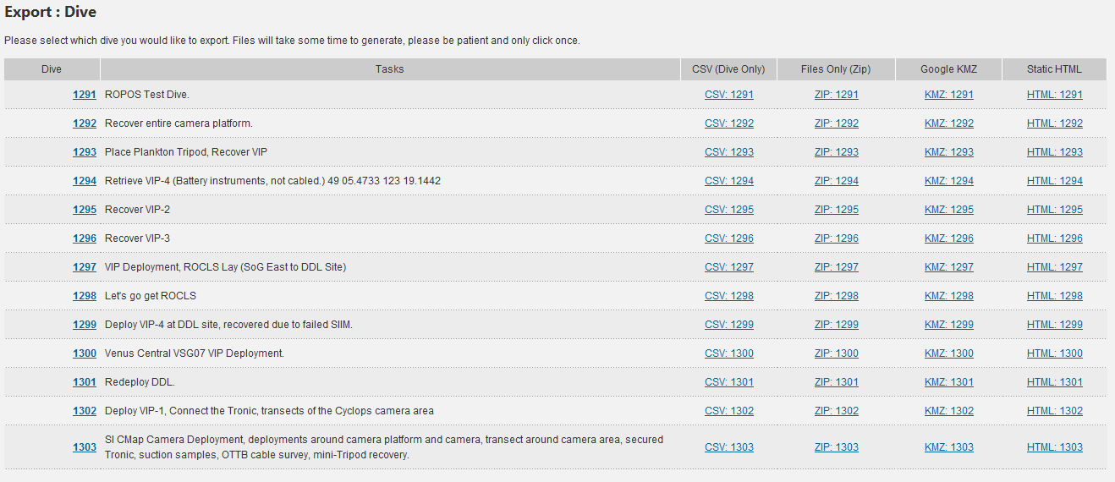
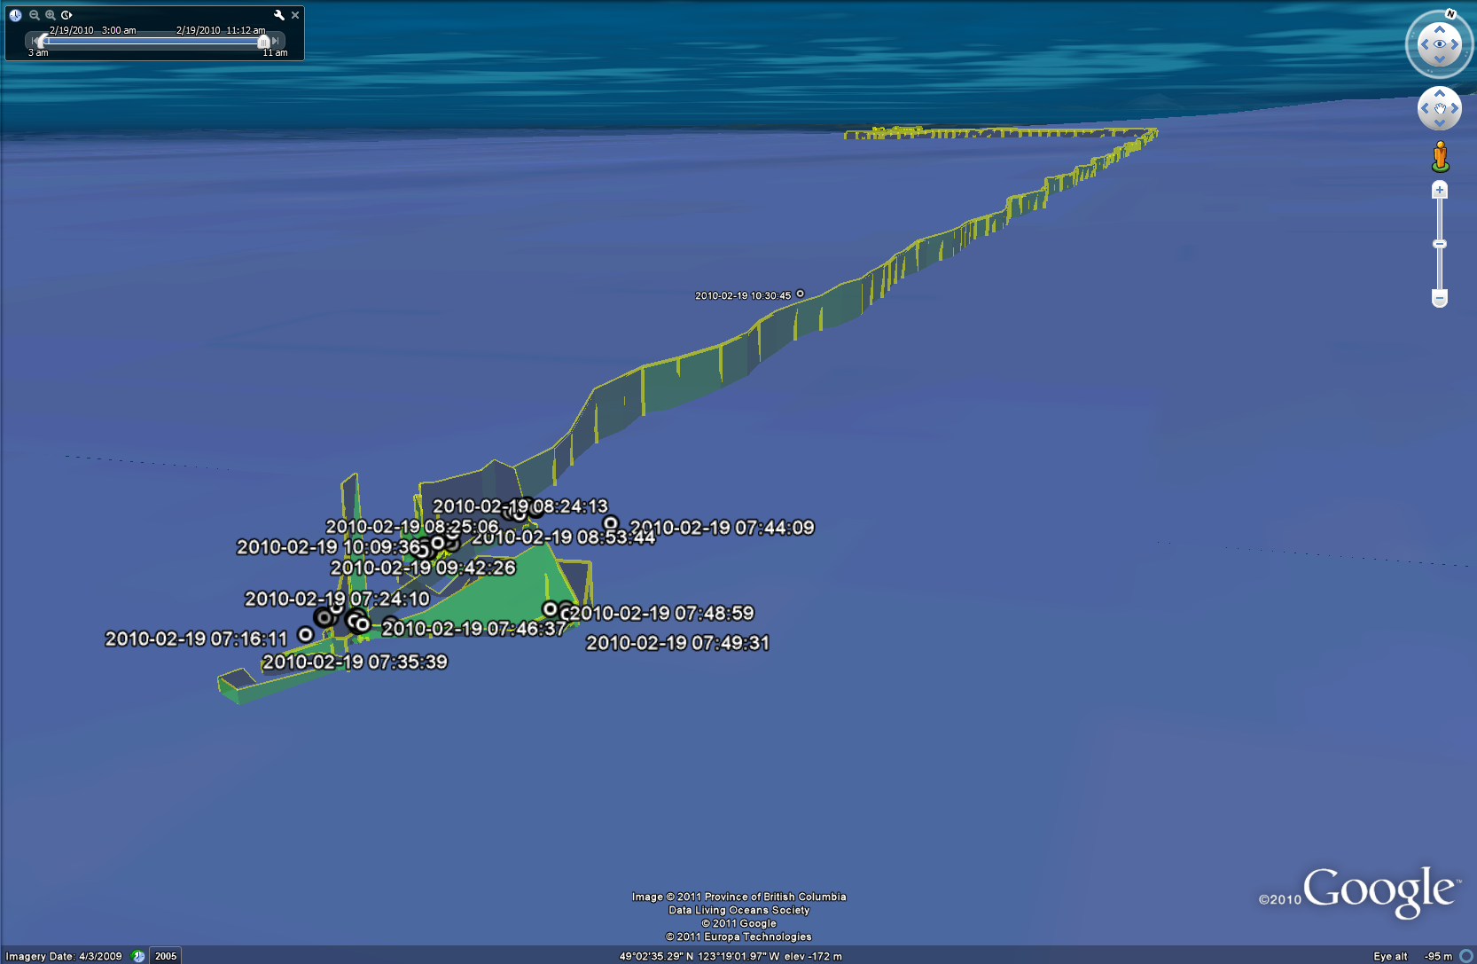
EXPORTS and Deliverables
KMZ
CSV
Custom
Exports
Static HTML
Database and files
"Live IRLS"
API

Slide 8
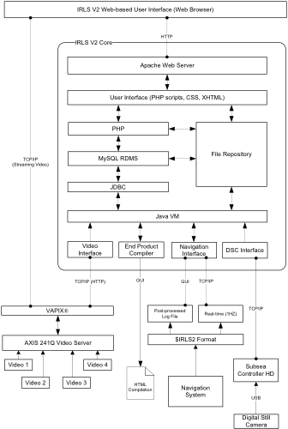
EXPORTS and Deliverables

Slide 9
THANK YOU
Thank you to all of the ROPOS users and crew that have provided the invaluable help and feedbacks for the continued development of IRLS.
ROPOS.COM

